Slide 1

Tzakar-Reminder
A Compose Multi-Platform Application
by Rami Mohammad Melhem

Slide 2
OVERVIEW
Introduction
Goals & Objectives
Limitations
Tools and Technologies
Challenges and Solutions
System Architecture Overview
Application Preview
Features Preview
Conclusion

Slide 3



INTRODUCTION
Tzakar-Reminder is a cross-platform task management app built with Jetpack Compose. It features smart reminders, task categorization, priority settings, and Firebase integration for seamless sync. With an intuitive design, it enhances productivity and organization. This showcases the efficiency of modern cross-platform development.
Page 1

Slide 4



GOALS AND OBJECTIVES
01
Unified Codebase for iOS and Android
02
Secure Firebase Authentication
.
03
Reminders Scheduling, Categorization, and Personalization
Page 2

Slide 5
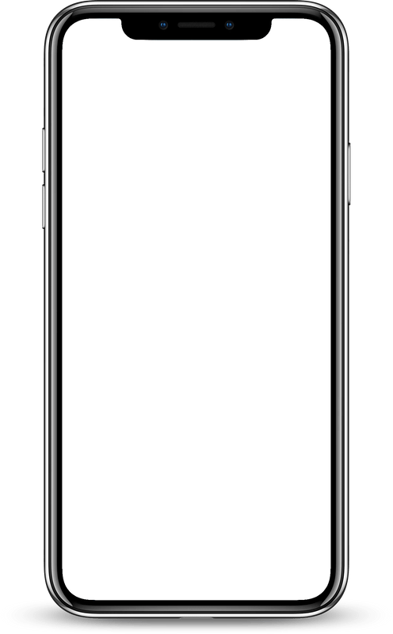
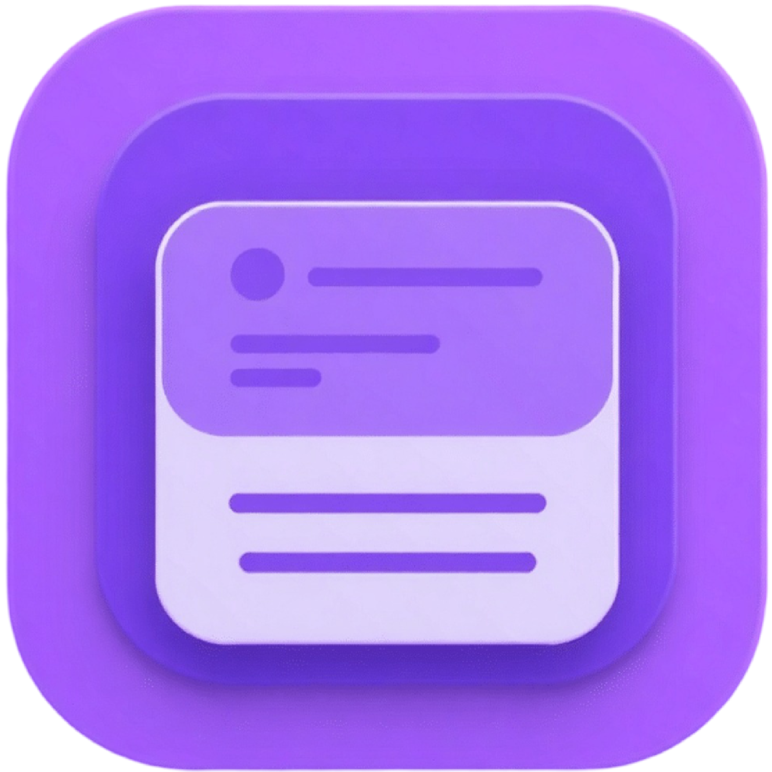
LIMITATIONS
No integration with external calendars.
Tzakar
Focus on individual users, not teams.
No Limited support for advanced AI or voice-based features.
Page 3

Slide 6







TOOLS AND TECHNOLOGIES
Development Environment & IDEs
Backend, Cloud Services
Architecture & Design Patterns
Page 4
Libraries & Frameworks

Slide 7
Cross-Platform Compatibility
Jetpack Compose Multiplatform and conducted platform-specific optimizations
State Management
CHALLENGES
Kotlin StateFlow and ViewModel architecture to maintain application stability.
consistent UI/UX across platforms
&
Material Design 3 principles
and ensured UI consistency across multiple devices
Solutions
Offline Data Synchronization
Navigation & Deep Linking Issues
DataStore for local caching
& realtime databse to sync data after connecting to internet
Voyager Navigation for structured navigation and deep linking support
Page 5

Slide 8

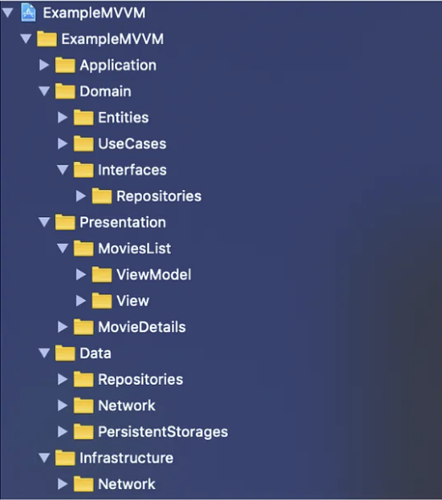
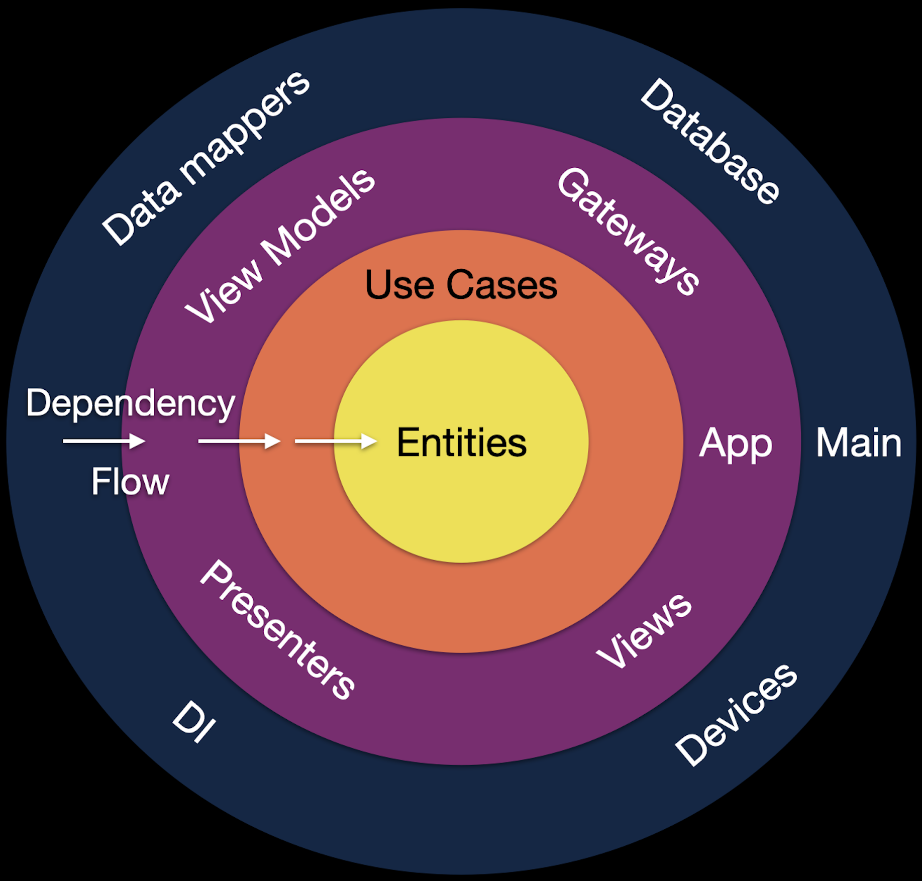
SYSTEM ARCHITECTURE OVERVIEW
Page 6
Clean Architecture And MVVM

Slide 9
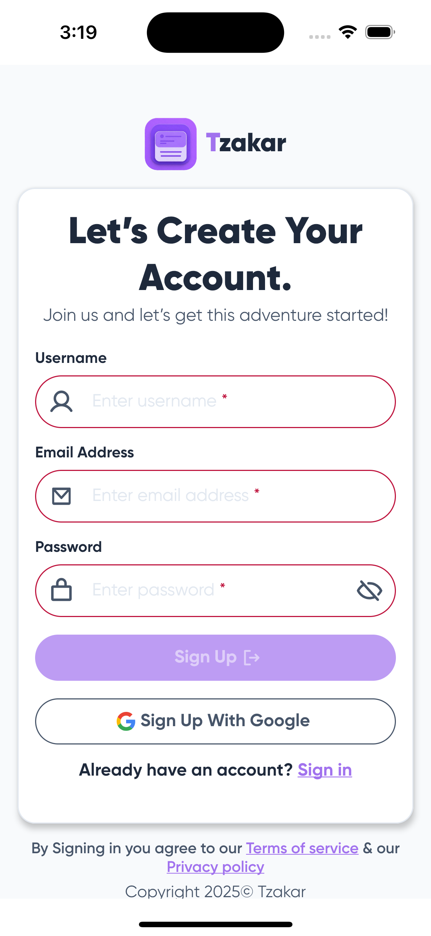
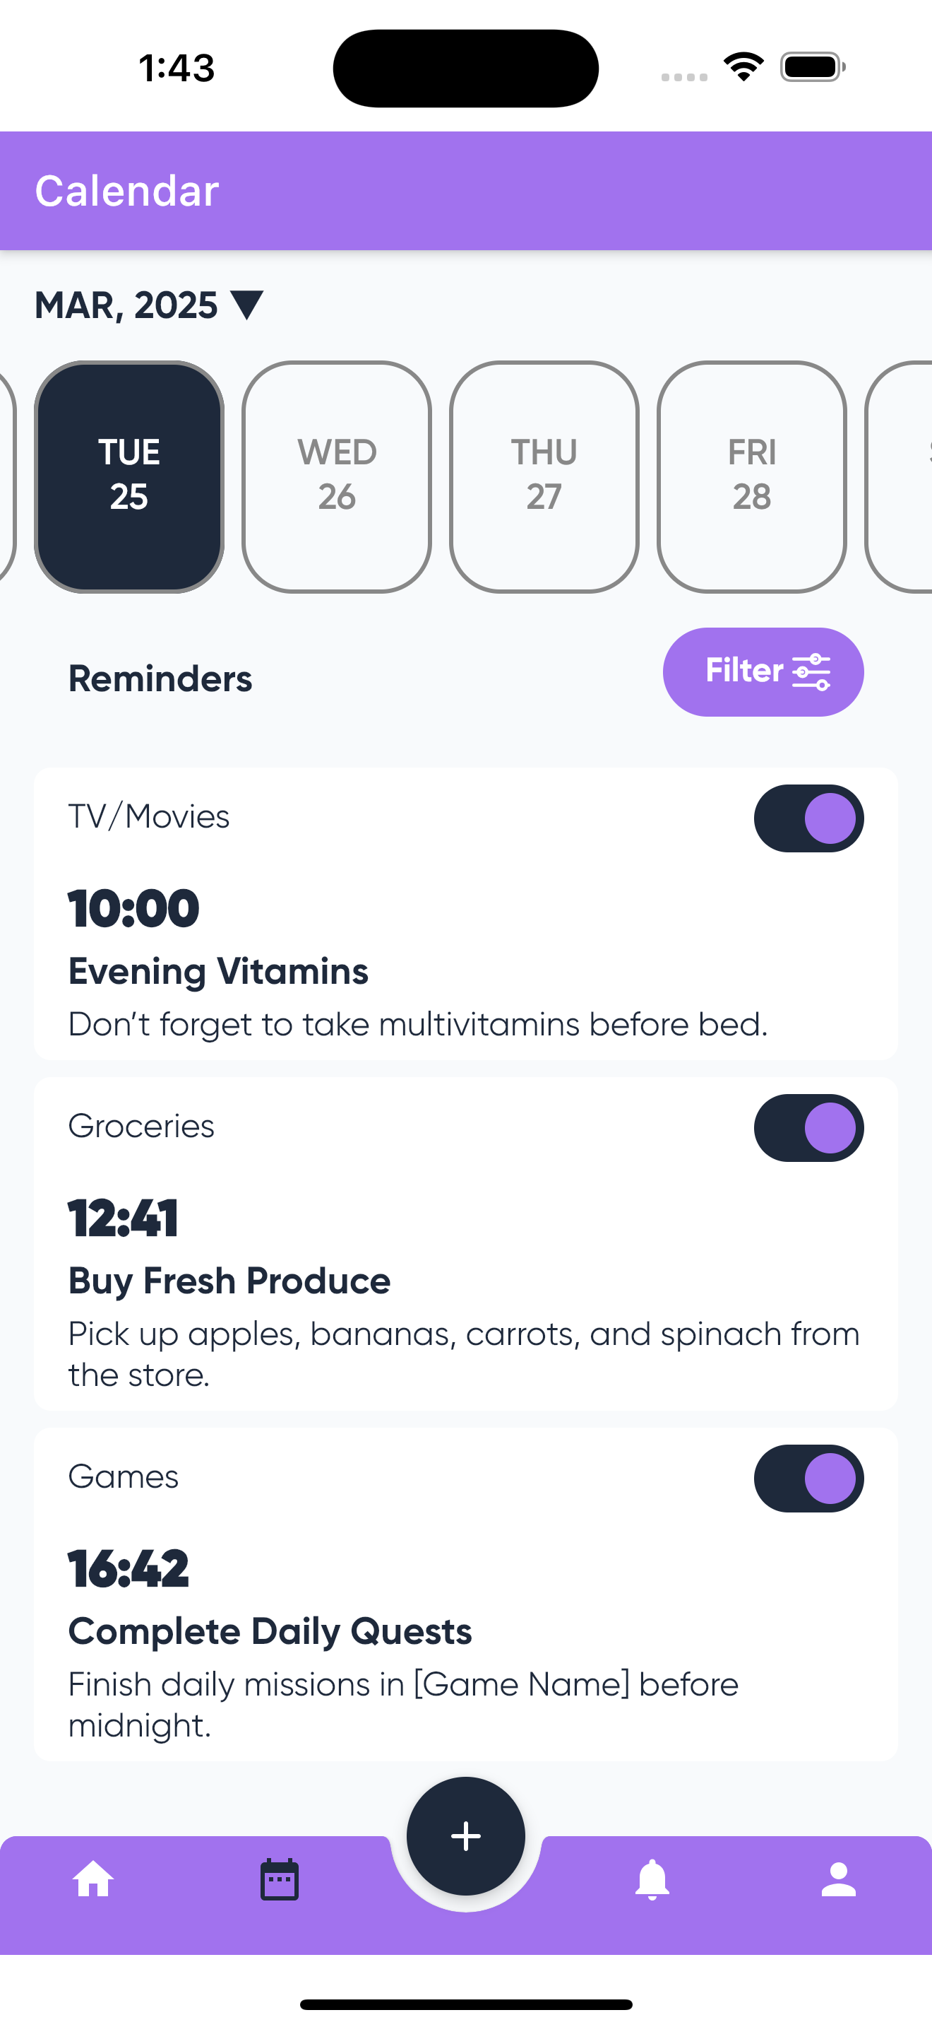
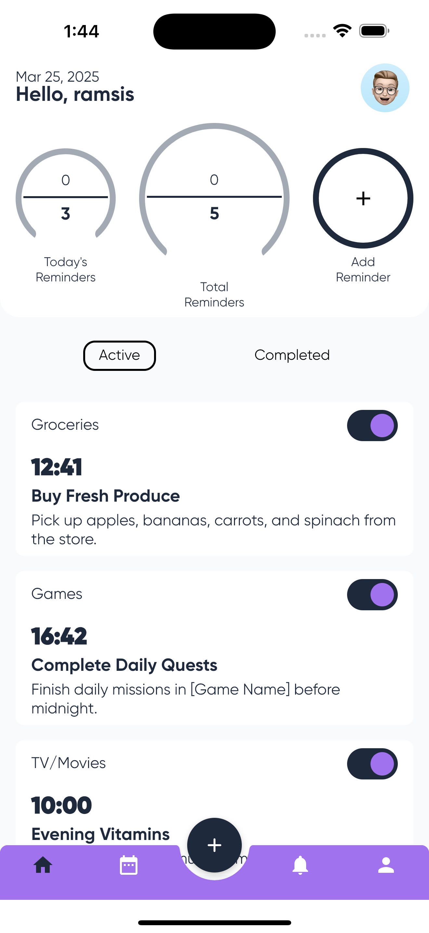
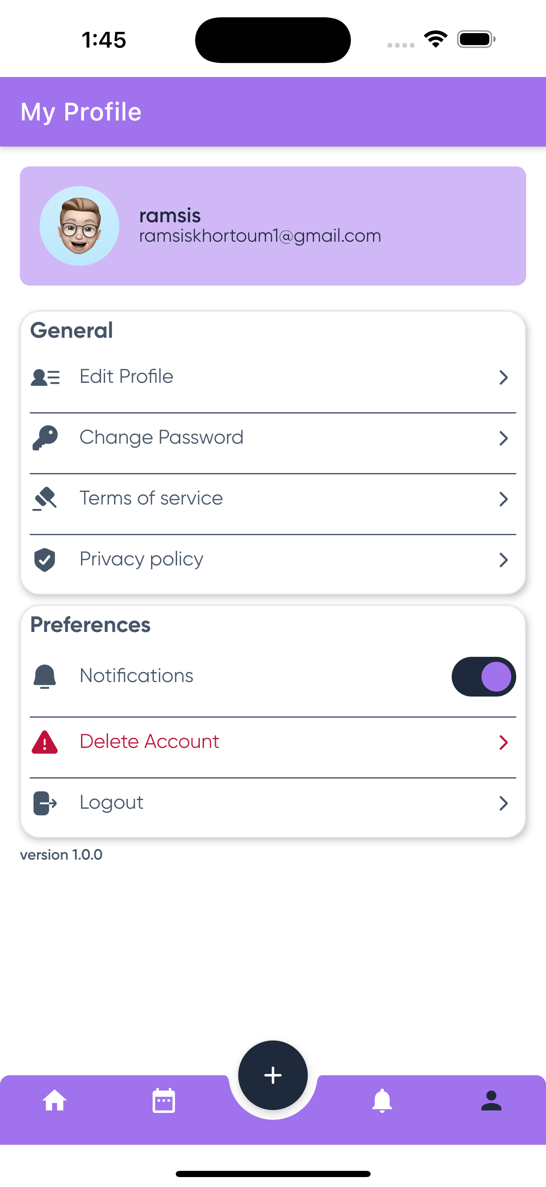
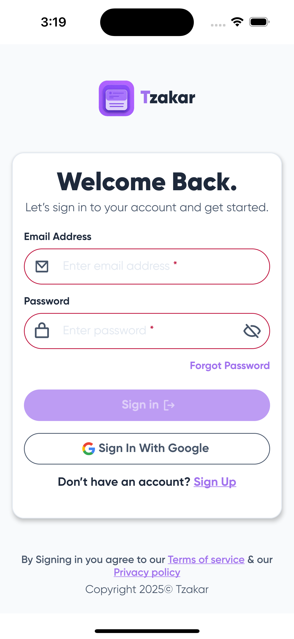
APPLICATION PREVIEW
Sign In
Home
Profile
Sign UP
Calendar
Page 8

Slide 10
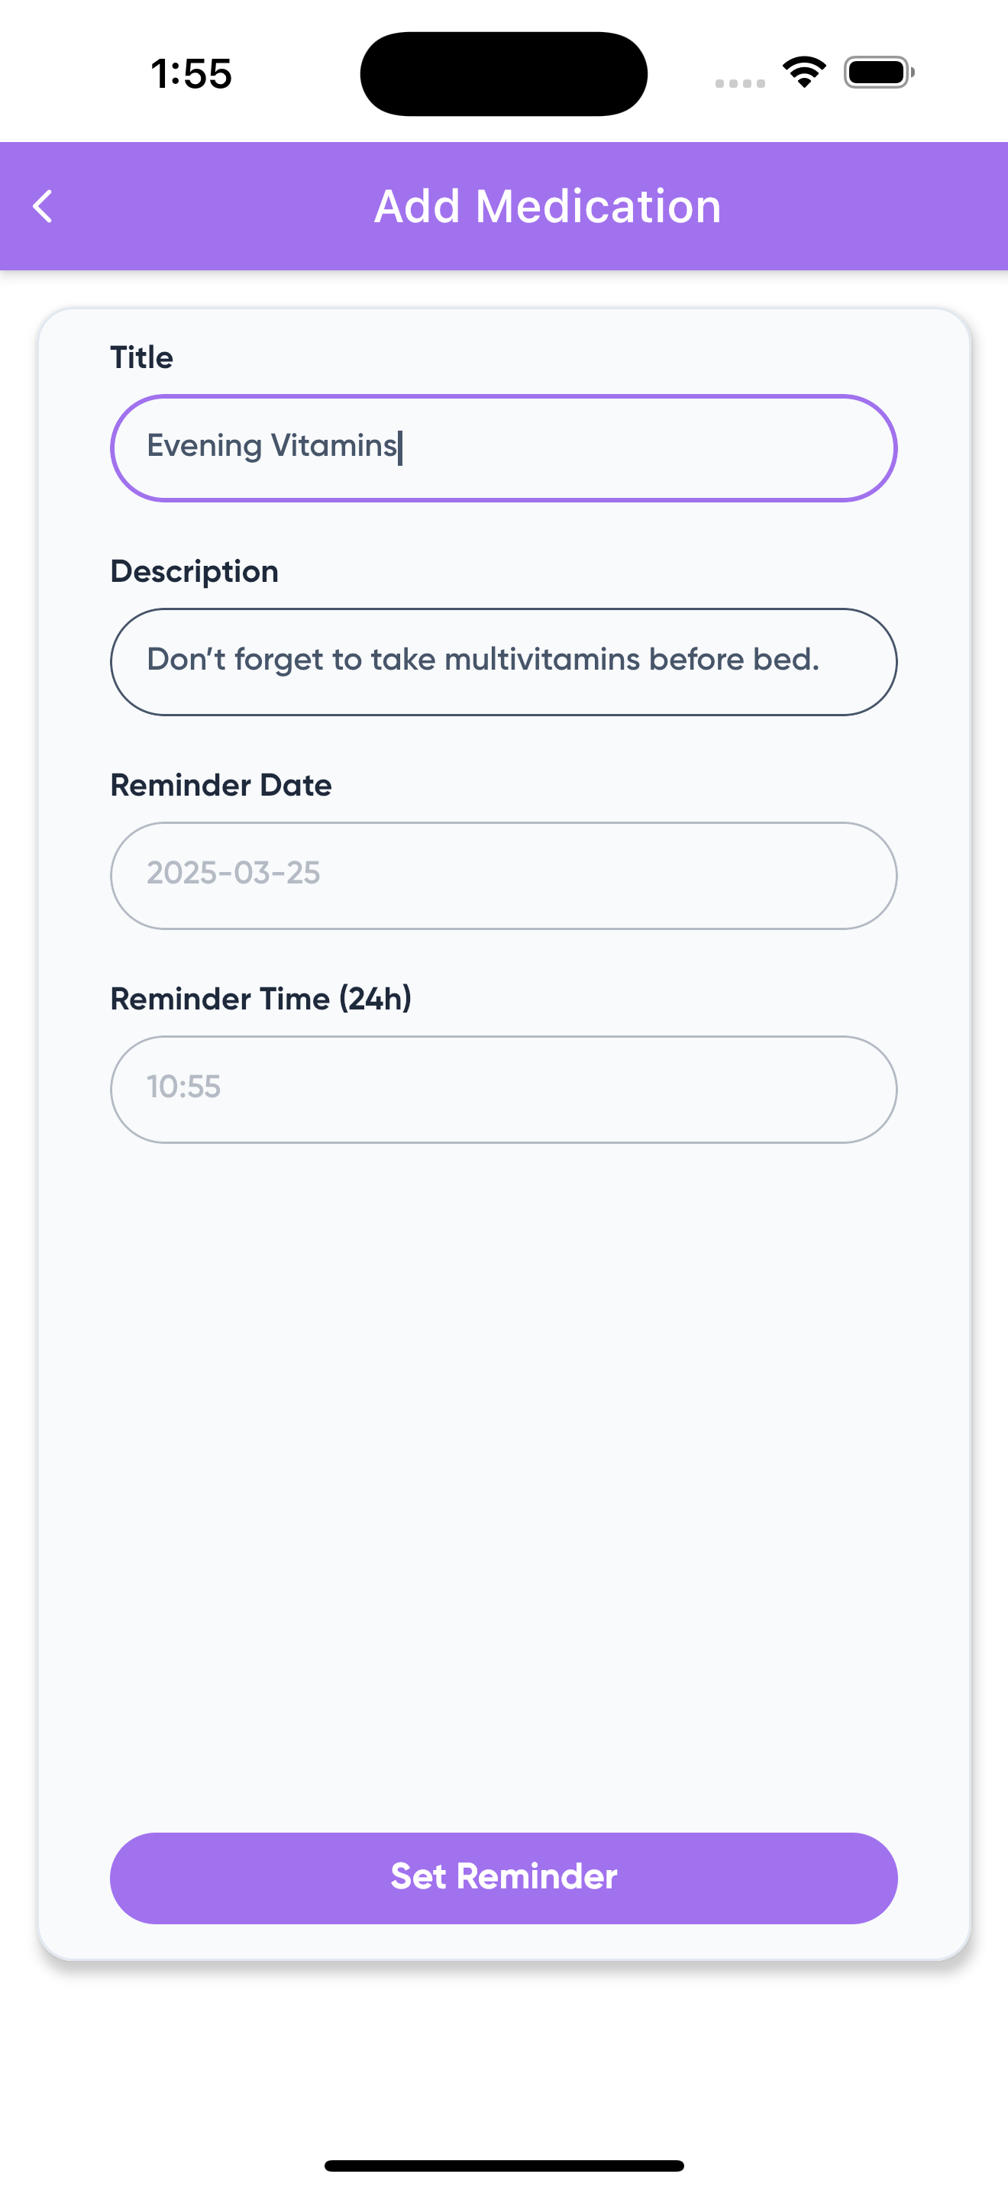
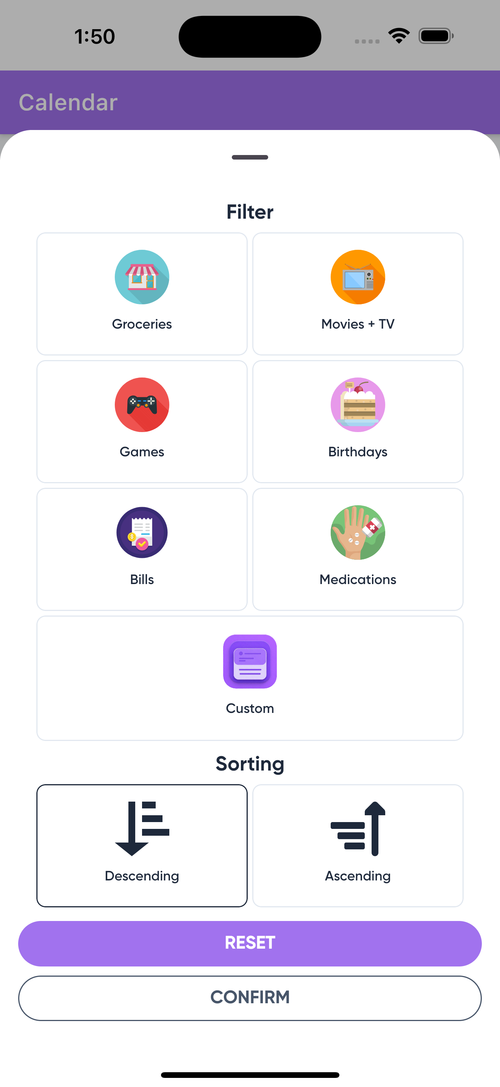
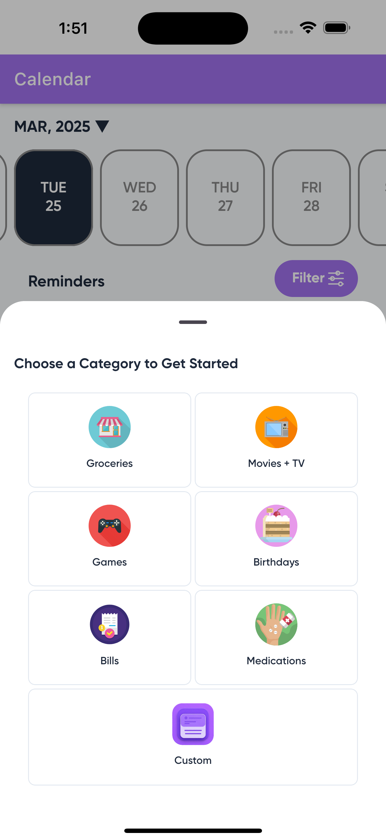
FEATURES
PREVIEW
01
Reminder Scheduling
02
Smart Sorting & Filtering
03
Task Organization & Categorization
Page 9

Slide 11


CONCLUSION
Successful development of a cross-platform Reminder application.
Features: Reminders, task categorization, Firebase integration, Task Categorization
.
Demonstrates the potential of Compose Multiplatform for scalable, efficient apps
Page 9

Slide 12


